Slide 1
Cross-Task Generalization via Natural Language Instructions
Daniel Khashabi Allen Institute for AI Joint w/ Swaroop Mishra and Hanna Hajishirzi
Notes:
I am Daniel Khashabi; for those who don’t know me, I am young investigator here at AI2.
And I am excited to tell you about our recent project!
This is a joint work with …
If you have any clarification questions, please interrupt me; otherwise, let’s delay all the open-ended questions till after the talk.

Slide 2
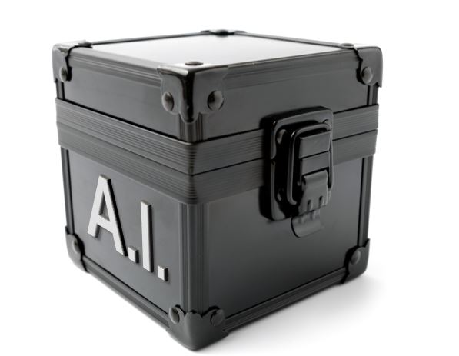
Task-Specific Models
Text: She chose to make a salad for lunch tomorrow and Sunday. Question: how long did it take for her to make a salad?
tasks
Question Typing
“event duration”
Task-specific models do not generalize across tasks.
There are MANY tasks!
Question Answering
“30mins”, “an hour”
Sentence Modification
“how often …”
Notes:
As you know, there are many tasks that we’d like to solve with our NLP model: …
For example, given this input which contains a text and a question, we may want to:
find the semantic type of this question that might help us in answer it
infer the answer to it,
or applies minimal modifications to input questions
and so many others tasks.
In the conventional paradigm, what build models for each task, typically based based on datasets built for each one.
This convention has had a good run: we have good systems that work well for each dataset
however, it is limiting our progress:
First, task-specific models do not generalize across one another
e.g., a question-answering model cannot solve classification tasks.
The idea that can have a model per task is just unrealistic and unscalable.
There are MANY tasks out there
There is no way that we can build models for every task.
In fact, we haven’t even defined what all the tasks are.

Slide 3
Beyond Task-Specific Models
Text: She chose to make a salad for lunch tomorrow and Sunday. Question: how long did it take for her to make a salad?
tasks
Question Typing
“event duration”
Question Answering
“30mins”, “an hour”
Sentence Modification
“how often …”
Notes:
So, we need a slightly different paradigm for our models.
the eutopia that I am after looks like this
Where we have a single system that has a broader scope, can solve a variety of tasks
But now the challenge is that:
the model does not know what task to solve for each input.
to make a model solve a variety of tasks, we should somehow define what expect from the model.

Slide 4
Beyond Task-Specific Models
Text: She chose to make a salad for lunch tomorrow and Sunday. Question: how long did it take for her to make a salad?
tasks
Question Typing
question-typing
“event duration”
Question Answering
question-answering
“30mins”, “an hour”
Sentence Modification
sentence-modification
“how often …”
Do not generalize to “unseen” tasks.
[Raffel et al. 2020]
Notes:
We’re not the first to think about this setup.
For example, Raffel et al (2020) (the T5 paper)
Used task-specific prefixes to to define the tasks
This enabled them to build a single model that functions on a variety of tasks.
However, the model’s scope/generalization is limited to the task it has seen.
It can do “question answering” if it was trained with a dataset that contained this exact prefix.
→ the model does not generalize to unseen tasks
-------------
TODO: there are many flavors of each task. There are many variants of typing task with different type flavors.
TODO: if there is more time, you can also mention NLP decathaton
you can also compare with UnifiedQA
Or you can talk about the vision team’s system

Slide 5
Beyond Task-Specific Models
human readable definitions; fully define the task
Text: She chose to make a salad for lunch tomorrow and Sunday. Question: how long did it take for her to make a salad?
tasks
Question Typing Instructions
Indicate the type of temporal phenomenon in the question …
Question Typing
“event duration”
Question Answering Instructions
In this task we ask you to write answer to the given question. …
Question Answering
“30mins”, “an hour”
Sentence Mod. Instructions
Label a question that is free of any grammatical/logical errors w/ 'yes’ …
Sentence Modification
“how often …”
Instructions define a task explicitly in natural language.
Notes:
The setup that we’re exploring here is an extension of the previous idea, except that instead of task prefixes we have instructions which define a task explicitly in natural language.
unlike task prefixed, instructions are human-readable definitions that are expected to fully define the task
-------
# textual descriptions of the target tasks.
We know humans can understand and execute these instructions.
The question is whether we can enable machines to follow instructions and execute it.

Slide 6
Cross-Task Generalization
Text: She chose to make a salad for lunch tomorrow and Sunday. Question: how long did it take for her to make a salad?
tasks
Question Typing Instructions
Indicate the type of temporal phenomenon in the question …
Question Typing
“event duration”
Question Answering Instructions
observed
tasks
In this task we ask you to write answer to the given question. …
Question Answering
“30mins”, “an hour”
Sentence Mod. Instructions
Label a question that is free of any grammatical/logical errors w/ 'yes’ …
Sentence Modification
“how often …”
evaluation
tasks
Explicit Answerability Instructions
Respond "yes" if the text contains an explicit answer to the given question. …
Explicit answerability
“no”
Notes:
Now, let’s say I am allowed to use these tasks as a source of supervision for my model.
Given this supervision, we define and measure cross-task generalization, as the ability to solve unseen tasks.
For example, .....
If the resulting model, truly makes use of the instructions, it should be able to ”understand” the new task based on its instructions and act accordingly.
You might ask, why is this even possible?
Humans are the real proof of a system that have this kind of generalization.
Crowdworkers, for example, simply read textual instructions or example and do annotations tasks.
Now we're asking whether models can also show this kind of generalization to unseen tasks?
--------------------------------------
So, this should define my setup. Let’s see how we’re going to study this.

Slide 7
Instructions Paradigm: Challenges
There is no benchmarks containing natural language instructions for a diverse range of of tasks.
Unclear whether models benefit from task “instructions”.
We present a dataset of natural instructions for a wide variety of tasks!
We show empirical evidence of their benefits!
Notes:
There are two key limitations along the path towards studying our problem. …
.... and that's basically what I'm gonna show for the remainder of my talk.

Slide 8
Natural-Instructions: Overview
Natural Instructions:
61 tasks and instructions
160k instances (input -> outputs)
Input: She chose to make a salad for lunch tomorrow and Sunday.
Instructions: generating “duration” questions task
In this task, we ask you to write a question that involves “event duration", based on a given sentence. Here, event duration is defined as the understanding of how long events typically last. For example, “brushing teeth”, usually takes few minutes. ….
Output: “how long did it take for her to make a salad?
Notes:
We introduce a dataset that we called “natural instructions”.
Like I motivated earlier, here is the setup in our dataset.
Each task is defined via natural language instructions:
our instructions are actually much more detailed than this, as I’ll show later.
And an input, which is mapped to an output.
Overall, our dataset which contains …
In the next few slides I am going to explain how we put together this dataset.
------------
Should this crowdsourcing picture move to the next slide?

Slide 9


Natural-Instructions: Construction (1)
collecting existing datasets
Use existing datasets and the instructions used to crowdsource them
dividing crowdsourcing instructions into minimal tasks
(Efrat & Levy, 2020)
Output
instructions schema
Input
A typical data construction pipeline
mapping crowdsourcing instructions to the schema
Notes:
Early on we noticed that a cheap way to construct our desired dataset is to use existing available datasets
Most of them contains human-readable instructions that were given used to construct them.
Why not we use these instructions for our purpose.
We’re not the first to think about this idea.
For instance, Efrat & Levy also thought along similar lines.
... but this is the first time that is done in this scale AND also leads to positive results in terms of model generalization.
------------
Should this crowdsourcing picture move to the next slide?

Slide 10
Natural-Instructions: Construction (1)
collecting existing datasets
Contacted dataset authors to access their crowdsourcing instructions and the associated annotations
CosmosQA [Huang et al. 2019]
DROP [Dua et al. 2019]
Essential-Terms [Khashabi et al. 2017]
MCTACO [Zhou et al. 2019]
MultiRC [Khashabi et al. 2018]
QASC [Khot et al. 2020]
Quoref [Dasigi et al. 2019]
ROPES [Lin et al. 2019]
Winogrande [Sakaguchi et al. 2020]
dividing crowdsourcing instructions into minimal tasks
instructions schema
mapping crowdsourcing instructions to the schema
Notes:
We contacted the authors of several recent datasets and obtained the instructions that were used for crowdsourcing them.
As you can see, the list is a bit skewed towards QA datasets. It’s not by design, but rather, these were more available to us.

Slide 11
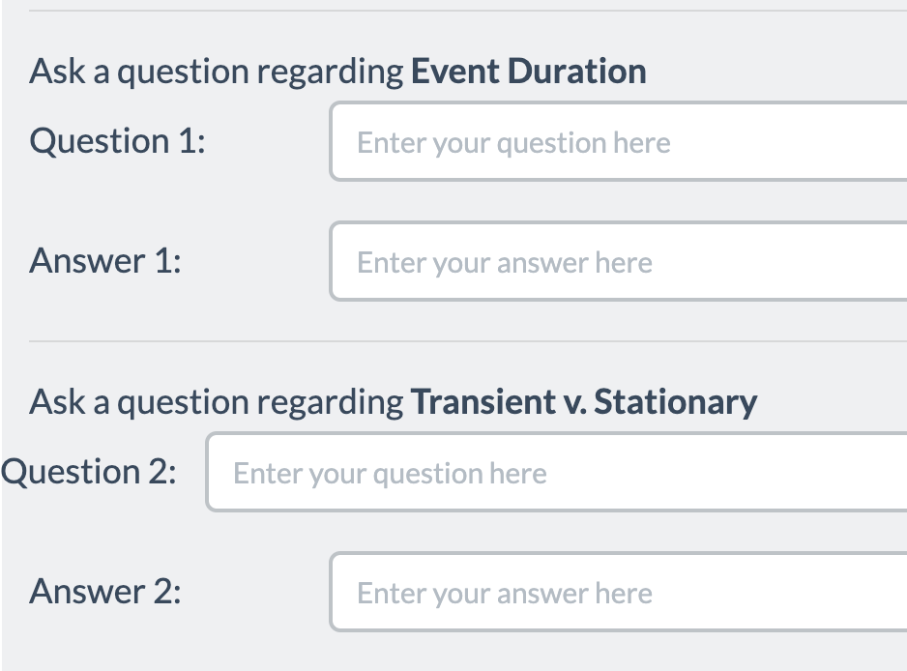
Natural-Instructions: Construction (2)
collecting existing datasets
Crowdsourcing instructions tend to involve multiple annotation steps.
Split them to self-contained tasks.
dividing crowdsourcing instructions into minimal tasks
task1
instructions schema
task2
MC-TACO [Zhou et al. 2019]
task3
mapping crowdsourcing instructions to the schema
task4
Notes:
Early on, we observed that, almost all the crowdworking instrucions include sequences of annotation steps.
For example, the screenshot shown here, taken from MCTaco dataset, shows a box for writing a …
This dataset’s complete instructions actually contains 19 independent annotations steps.
We divide crowdsourcing instructions into multiple subtasks that are minimal and standalone.
For example ….
This process results in a more consistent definition of tasks, enabling a successful mapping
It is this splitting process that results in 61 independent tasks, based on our initial 9 datasets.
---------------
TODO:
- you may wanna show statistics on the number tasks per dataset
- I think we can use the examples in Table 1

Slide 12
Natural-Instructions: Construction (3)
collecting existing datasets
Crowdsourcing instructions are written in a variety of ways.
A unified schema for consistent representation across tasks.
dividing crowdsourcing instructions into minimal tasks
instructions schema
Definition
Things to Avoid
Emphasize/Caution
Prompt
instructions schema
Definition
Things to Avoid
Emphasize/Caution
Prompt
Positive Examples
Negative Examples
Input
Output
Input
Output
mapping crowdsourcing instructions to the schema
Reason
Reason
Suggestion
Notes:
Instructions used in crowdsourcing the source datasets are written by distinct authors for various purposes, and they are different in a variety of ways.
We did a pilot study
and based on the common elements of the crowdsourcing instructions, we came up with a schema to to represent our instructions.
Let me briefly define the important fields I am going to refer to, in this schema:
DEFINITION provides the core detailed instructions for a task.
THINGS TO AVOID contain instructions regarding undesirable annotations that must be avoided.
These are helpful in defining the scope of a task and the space of acceptable responses.
EMPHASIS AND CAUTION are highlighted statements in the crowdsourcing instructions,
.. intended to be emphasized or warned against.
POSITIVE EXAMPLES are examples of desirable outputs.
NEGATIVE EXAMPLES providing examples of what must not be produced.
PROMPT is a single sentence summary of the task that often appears at the end of the instructions, just before the input.
----------
As you probably know, crowdsourcing instructions are HTML documents that need to convert them plain text.
But this is not something that we can easily automate, since are written by various authors for purposes, and they are different in a variety of ways. So, it’s something that we had to do manually.
TODO: very different, but they're a similar high-level structure. --> hnence
TODO:
- make it a bit more compact
- just like fig 3, separate instances from the instructions
- we can say: Our instruction schema is the result of our pilot study conducted on a subset of datasets. B

Slide 13
Natural-Instructions: Construction (4)
collecting existing datasets
This process was done by an expert annotator and verified by another.
Mapping crowdsourcing instructions to our schema:
Retained the original phrasing.
Redacted verbose/repetitive content.
Created negative examples wherever they were absent.
Took ~10 hours for each task.
dividing crowdsourcing instructions into minimal tasks
instructions schema
mapping crowdsourcing instructions to the schema
Notes:
Obviously, easy said than done:
.... which goes to show that the process of converting existing datasets to our schema was not a trivial one.
TODO:
- make it a bit more compact
- just like fig 3, separate instances from the instructions
We drop uncessary sentences:
E.g., below we provide some examples:

Slide 14
Natural Instructions: Statistics
61 tasks
Notes:
In sum, the resulting dataset consists of 61 tasks ....
Here is the distribution of the tasks included in the datasets, aggregated according to their high-level type.
As you can see, the dataset has many tasks that are related to QA.
For example, question generation, generating correct answers to questions, generating incorrect answers.
But there are other tasks, too;
All sorts of classification or minimal modification of inputs.
Let me emphasize that not all tasks in the same category have are actually identical.
Like I said before, they're typically written by different authors for different purposes.
Any two tasks, say in the question generation, are different from each other.

Slide 15
Natural-Instructions: Example
input instance (paragraph, story, etc.)
Definition
Things to Avoid
Emphasize/Caution
Prompt
Positive Examples:
Negative Examples:
an output (question, answer, label, etc.)
Input
Output
Input
Output
Reason
Reason
Suggestion
Notes:
Back to the big picture and remind you about the setup:
based on the given instruction (represented based on our schema), the model is expected to apply a change to the input (like a paragraph, etc) and map it to the output

Slide 16
Natural-Instructions: Example
input instance (paragraph, story, etc.)
Generating “duration” questions task
Definition: In this task, we ask you to write a question that involves “event duration", based on a given sentence. Here, event duration is defined as the understanding of how long events typically last. For example, “brushing teeth”, usually takes few minutes.
Things to Avoid: Don't create questions which have explicit mentions of answers in text. Instead, it has to be implied from what is given. In other words, we want you to use "instinct" or "common sense".
an output (question, answer, label, etc.)
Emphasize/Caution: The written questions are not required to have a single correct answer.
Positive example 1
Input: Sentence: Jack played basketball after school, after which he was very tired.
Output: How long did Jack play basketball?
Reason: The question asks about the duration of an event; therefore it's a temporal event duration question.
…
Notes:
Here is an actual instruction, for the task of ...

Slide 17
Natural-Instructions: Example
Input: She chose to make a salad for lunch tomorrow and Sunday.
Generating “duration” questions task
Definition: In this task, we ask you to write a question that involves “event duration", based on a given sentence. Here, event duration is defined as the understanding of how long events typically last. For example, “brushing teeth”, usually takes few minutes.
“how long did it take for her to make a salad?
Things to Avoid: Don't create questions which have explicit mentions of answers in text. Instead, it has to be implied from what is given. In other words, we want you to use "instinct" or "common sense".
Emphasize/Caution: The written questions are not required to have a single correct answer.
Positive example 1
Input: Sentence: Jack played basketball after school, after which he was very tired.
Output: How long did Jack play basketball?
Reason: The question asks about the duration of an event; therefore it's a temporal event duration question.
https://instructions.apps.allenai.org/explore
…
Notes:
For this given input, ….

Slide 18
Encoding Instructions
input instance (paragraph, story, etc.)
Definition
Things to Avoid
Emphasize/Caution
Prompt
Positive Examples:
Negative Examples:
some output (question, answer, label, etc.)
Input
Output
Input
Output
Reason
Reason
Suggestion
text to text architectures:
BART [Lewis et al. 2019]
GPT3 [Brown et al. 2020]
Notes:
For evaluating this setup, we use text to text architectures . . .

Slide 19
Encoding Instructions
input instance (paragraph, story, etc.)
Definition
Things to Avoid
Emphasize/Caution
Prompt
Positive Examples:
Negative Examples:
enc(.)
some output (question, answer, label, etc.)
Input
Output
Input
Output
Reason
Reason
Suggestion
text to text architectures:
BART [Lewis et al. 2019]
GPT3 [Brown et al. 2020]
Notes:
Now, to use these architectures, we need an encoding function that maps the input instance and instruction into plain text.
All that this function does is to concatenate various instructions fields and the input instance and feeds that text to the model.

Slide 20
Empirical Questions
input instance (paragraph, story, etc.)
Definition
Things to Avoid
Emphasize/Caution
Prompt
Positive Examples:
Negative Examples:
enc(.)
some output (question, answer, label, etc.)
Input
Output
Input
Output
Reason
Reason
Suggestion
text to text architectures:
BART [Lewis et al. 2019]
GPT3 [Brown et al. 2020]
Q1: What fields of the instructions are the most helpful for the models?
Q2: Does GPT3 understand instructions?
Q3: Can smaller model (such as BART) be tuned to follow instructions?
Notes:
Obviously, there are all sorts of questions that we can study about this setup.
Here are several ones that we're going to look into.

Slide 21
Experiment: Evaluating GPT3
Does GPT3 understand task instructions?
Instructions improve GPT3’s performance! 🎉
All instruction elements (except negative examples) help!
A wide margin to be solved 🤔
A task-specific BART scores ~70%
output quality (ROUGE)
0 20 40 60 70
30
prompt
35
prompt + definition
24
44
full instructions
full instructions
- negative ex.
task-specific
models
Notes:
First, we take a look at GPT3’s performance when prompted with our instructions.
(read the plots)
As it can be seen, there are encodings of the instructions that improve GPT3's performance, over the "prompt"-only base encoding.
…. which is quite encouraging.
Turns out that that when "all instructions” are given to the model, it does not work best.
The best encoding is when the model observes everything except "negative" examples.
... indicating all instruction except negative examples, help guide GPT3 towards the right behavior.
Why negative examples confuse GPT3 is not fully clear to us.
We have hypotheses (happy to discuss it later); it's something that requires a more careful study.
Despite these positive trends, this model is far from perfect.
Here the red line is a BART model trained and evaluated on each task
this is the conventional setup: one model per task, with no cross-task generalization
Nevertheless, it indicates a useful estimate of the upperbound for our problem.
And as you see, GPT3 performs much worse than this estimated upperbound.
I would remind you that the GPT-3 model here is used out-of-the-box, without fine-tuning to our tasks.

Slide 22
Evaluating Fine-tuned Models: Setup
Splitting the data for fine-tuning a smaller model:
Randomly split the tasks
12 evaluation tasks
49 supervision tasks
Leave-one-category-out
Notes:
While can’t fine-tune GPT3 due to its massive size, that’s not a limitation for smaller models.
To study whether a model would benefit from observing and learning from instructions, we create supervision and evaluation split.
The first setup that we study is random splits:
We randomly pick 12 tasks for evaluation and the rest for supervision.
One concern regarding this random split is potential similarity/overlap of the tasks in the train and evaluation tasks.
To address this concern we also split the data in a way that one category of tasks is completely excluded from the supervision set.
For instance, ...

Slide 23
Evaluating Fine-tuned Models: Setup
Splitting the data for fine-tuning a smaller model:
Randomly split the tasks
12 evaluation tasks
49 supervision tasks
Leave-one-category-out

Slide 24
Evaluating Fine-tuned Models: Setup
Splitting the data for fine-tuning experiments:
Randomly split the tasks
12 evaluation tasks
49 supervision tasks
Leave-one-category-out

Slide 25
Exp: Generalization to a Random Split
Can models learn to act w.r.p. instructions?
BART (base) [Lewis et al. 2019]
Small models, too, generalize to unseen tasks! 🥳
All instruction elements (except negative examples) help!
output quality (ROUGE)
0 10 20 30 40
13
no instructions
20
30
prompt
32
prompt + definition
35
full instructions
full instructions
- negative ex.
Notes:
Now, given the random split of the tasks, we train a bart model on the supervision tasks and evaluate it on the heldout tasks.
This process is done for different encodings of the instructions. …
As you can see, the trend is similar to that of GPT3:
Our small BART model gains better cross-task generalization with instructions.
Pretty much all the instruction elements help with this generalization, except negative example which seem to be distracting the model.

Slide 26
Exp: Generalization to Unseen Categories
Evaluate on task of a particular category and train on the rest.
Instructions improve generalization to tasks of unseen categories! ✨
output quality (ROUGE)
output quality (ROUGE)
0 10 20
0 10 20
11
no instructions
18
no instructions
6
10
prompt + definition
19
prompt + definition
17
21
19
full instructions
full instructions
full instructions
- negative ex.
full instructions
- negative ex.
eval. on unseen “answer generation” tasks
eval on unseen “question generation” tasks
Notes:
We repeat the same experiment in a setup where all the tasks of a parricular type are excluded from the supervision set.
For example, on the left side,
the evaluation is done on the answer generation tasks
and none of which are observed in the training set.
Similarly on the right side, …
The conclusion is the same as the earlier ones: …
which is promising …

Slide 27
Exp: Generalization vs Size of Observed Tasks
How the number of observed tasks affects cross-task generalization?
Generalization to unseen tasks improves with more observed tasks! 🔥
40
30
20
10
output quality
Full Instructions
No Instructions
10 20 30 40 50
# of observed tasks
Notes:
The last experiment I want to show concerns with the question of:
How the number of observed tasks affects cross-task generalization.
We supervise the BART model with various number of tasks, under two input encodings:
On one extreme, the model does not see the task instructions (only a bunch of input sentence; similarly to how we conventionally build models)
On the other extreme, the model observes the whole instructions
You can see the trends here:
When the model does not get to see task instructions, there is no tangible value in observing more tasks.
In contrast, the generalization of the models that encode instructions improves with observing more tasks.
This is an exciting observation since it suggests that scaling up our dataset to include more tasks may lead to stronger instruction-following systems.
--------------
We fix 6 tasks (one from each category) as our evaluation tasks,
and from the remaining tasks we randomly sample 5, 528 15, 37, 55 tasks. Each point in the figure is averaged over 5 random subsampling of the training tasks.
--> more experiments in the paper

Slide 28
Lessons
Motivating Hypothesis:
Can machines generalize to unseen tasks, via natural language instructions?
Natural-Instructions: a dataset of many tasks and their crowdsourcing instructions/annotations.
Empirical evidence that:
Instructions help w/ generalization to unseen tasks!
There is notable room to make progress!
http://instructions.apps.allenai.org
Notes:
We were motivated by the observation that humans (e.g., crowdworkers) have a seamless generalize across tasks;
This naturally led to a hypothesis: …
To study this problem, we introduced …. .
Quite an extensive set of experiments on this dataset shows that:
These is promise here: …
However, many hurdles remain: …

Slide 29
That’s it!
Notes:
That’s all I had, I appreciate your time and attention.

Slide 30
Instructions Paradigm
Instructions provide a more general medium to express information, as compared to task examples.
Incorporate high-level knowledge.
Define a new task explicitly in natural language.
Instruction paradigm is a strict generalization of the current instance-only paradigm.
Learning from Instructions
Learning from task-specific input/outputs

Slide 31
“definition: ${def}
things to avoid: ${avoid}
emphasis/caution: ${emphasis}
Positive example1:
input: ${ex_in},
output: ${ex_out},
reason: ${ex_reas}
prompt:${prompt}
input: ${input}
output:”

Slide 32
Breadth of tasks
language understanding problems
puzzles/search problems
SQuAD
HotPotQA
Go
Chess
Depth of tasks
Notes:
Let me show the same point pictorially:
Think of this light blue shape as the space of all the problems we’re interested in.
The X-axis is the collection of problem definitions, or the metaphorical breadth of problems.
For example, problem definitions for Go, for SQuAD, or any other QA task.
The depth is the complexity of each problem space.
For example, within the domain defined by the rules of Go.
Similarly, for any NLP task.
The issue I am alarmed by is that we excessively focus on depth,
We try to make the most sophisticated Go player
Similarly, for NLP models, we try to make the strongest models (for each dataset)
But very little time is spent in the breadth, i.e., building models that support a border range of tasks (i.e., more breads).

Slide 33
Natural-Instructions: Construction (2)
collecting existing datasets
Crowdsourcing instructions tend to involve multiple annotation steps.
Split them to self-contained tasks
Input of each task: external data or annotations from earlier tasks
Output of each task: crowdworker annotations
Overall: 9 datasets → 61 tasks
dividing crowdsourcing instructions into minimal tasks
topic word generation
combing facts
question generation
answer generation
Incorrect answer generation
instructions schema
crowdsourcing instructions
for QASC [Khot et al. 2020]
mapping crowdsourcing instructions to the schema
Notes:
By this kind of splitting, we extract a variety of tasks from crowdsourcing templates of a dataset.
For example, in QASC: ....
-------------
TODO:
- you may wanna show statistics on the number tasks per dataset
- I think we can use the examples in Table 1

Slide 34
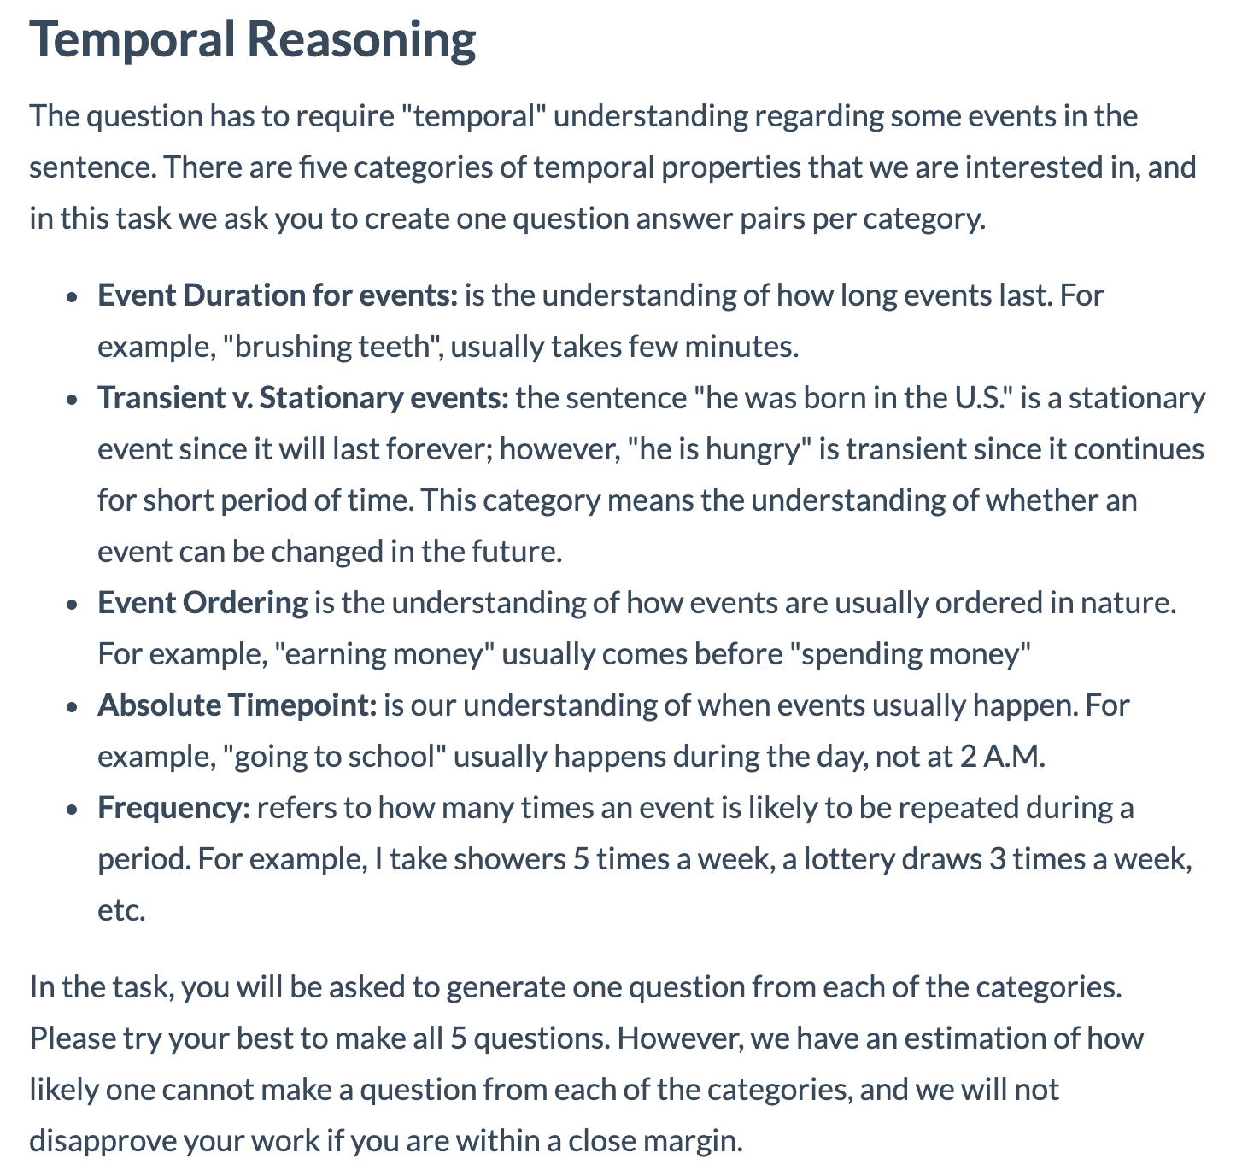
Natural-Instructions: Construction (3)
instructions schema
collecting existing datasets
Definition
Things to Avoid
Emphasize/Caution
Prompt
Positive Examples:
Negative Examples:
Positive example
Positive example
dividing crowdsourcing instructions into minimal tasks
Input
Output
Input
Output
Reason
Reason
Suggestion
instructions schema
mapping crowdsourcing instructions to the schema
MC-TACO [Zhou et al. 2019]
Notes:
• DEFINITION provides the core detailed instructions for a task.
--------------------
TODO:
- make it a bit more compact
- just like fig 3, separate instances from the instructions
We drop uncessary sentences:
E.g., below we provide some examples:

Slide 35
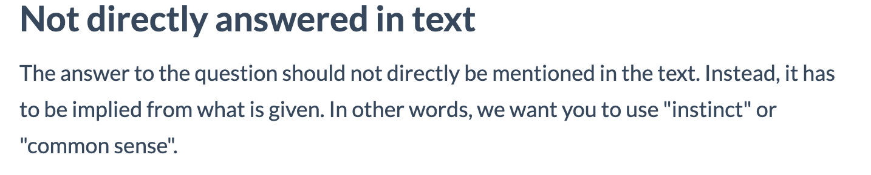
Natural-Instructions: Construction (3)
instructions schema
collecting existing datasets
Definition
Things to Avoid
Emphasize/Caution
Prompt
Positive Examples:
Negative Examples:
Positive example
Positive example
dividing crowdsourcing instructions into minimal tasks
Input
Output
Input
Output
Reason
Reason
Suggestion
instructions schema
mapping crowdsourcing instructions to the schema
MC-TACO [Zhou et al. 2019]
Notes:
THINGS TO AVOID contain instructions regarding undesirable annotations that must be avoided.
These are helpful in defining the scope of a task and the space of acceptable responses.
EMPHASIS AND CAUTION are short, but important statements highlighted in the crowdsourcing templates which were intended to be emphasized.
PROMPT is a single sentence command that often appears before the input instance and connects it to the instructions
--------------------
TODO:
- make it a bit more compact
- just like fig 3, separate instances from the instructions
We drop uncessary sentences:
E.g., below we provide some examples:

Slide 36
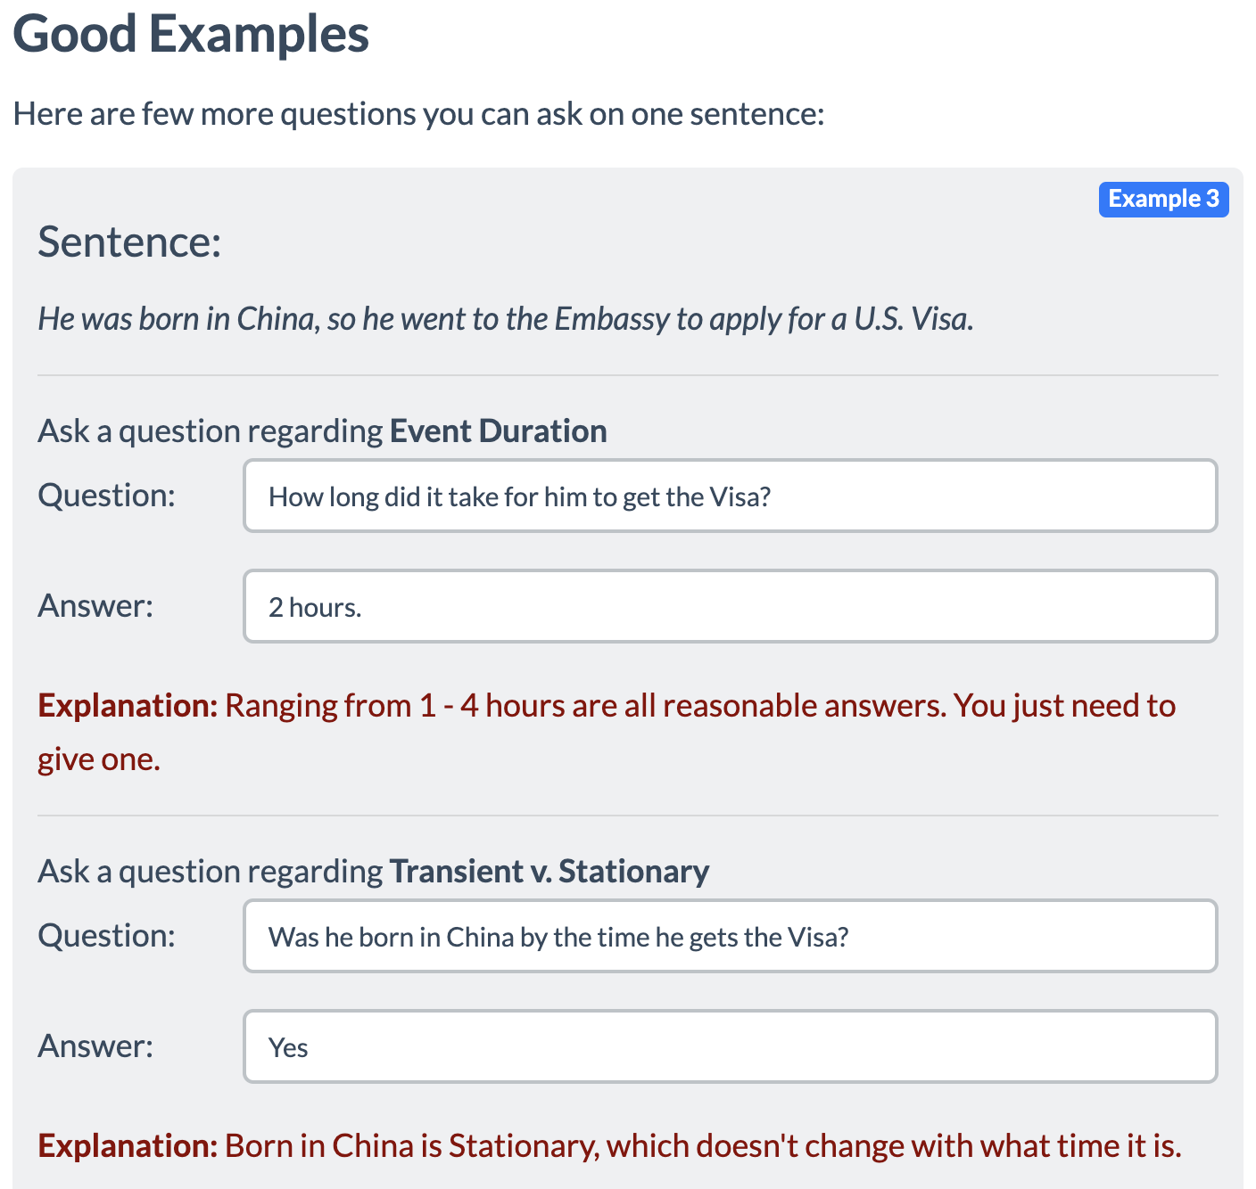
Natural-Instructions: Construction (3)
instructions schema
collecting existing datasets
Definition
Things to Avoid
Emphasize/Caution
Prompt
Positive Examples:
Negative Examples:
Positive example
Positive example
dividing crowdsourcing instructions into minimal tasks
Input
Output
Input
Output
Reason
Reason
Suggestion
instructions schema
mapping crowdsourcing instructions to the schema
MC-TACO [Zhou et al. 2019]
Notes:
• POSITIVE EXAMPLES contain inputs/outputs similar to the input given to a worker/system and its expected output, helping crowdworkers better understand a task
------------------
TODO:
- make it a bit more compact
- just like fig 3, separate instances from the instructions
We drop uncessary sentences:
E.g., below we provide some examples:

Slide 37
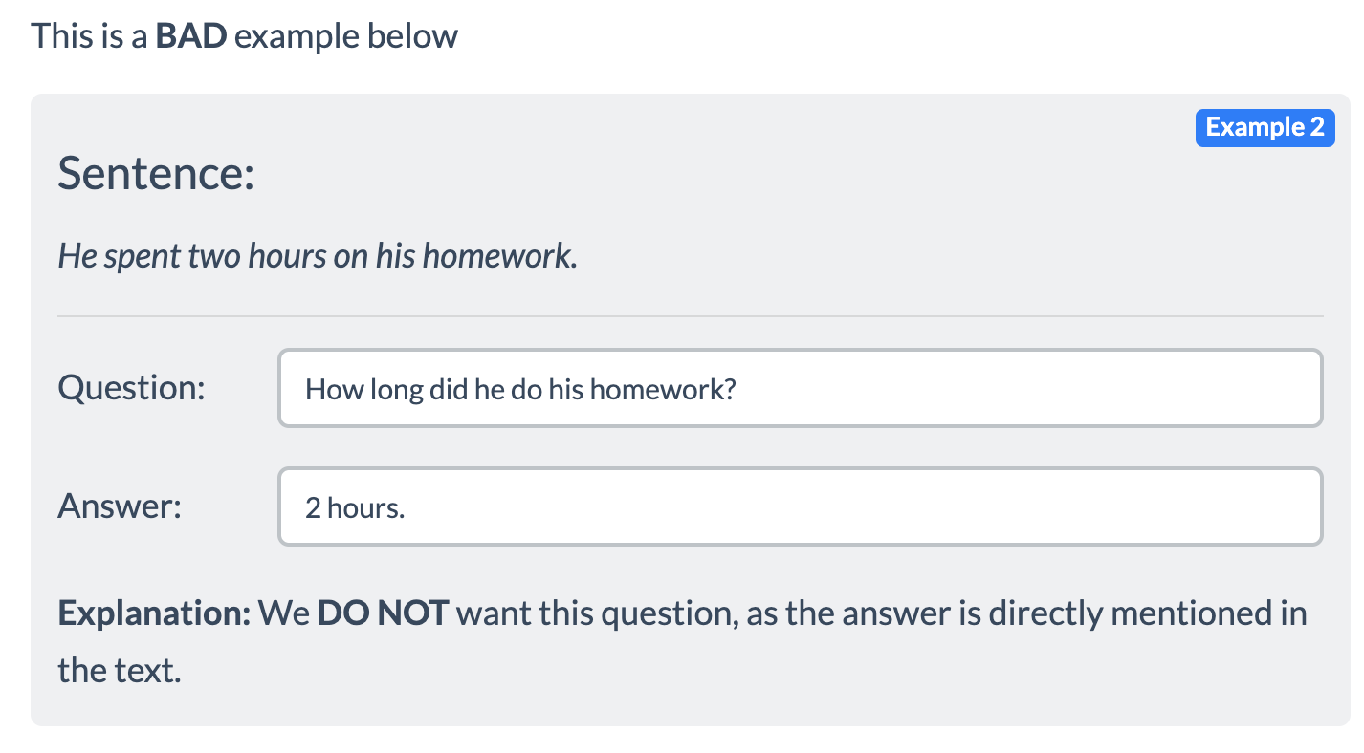
Natural-Instructions: Construction (3)
instructions schema
collecting existing datasets
Definition
Things to Avoid
Emphasize/Caution
Prompt
Positive Examples:
Negative Examples:
Positive example
Positive example
dividing crowdsourcing instructions into minimal tasks
Input
Output
Input
Output
Reason
Reason
Suggestion
instructions schema
mapping crowdsourcing instructions to the schema
MC-TACO [Zhou et al. 2019]
Notes:
NEGATIVE EXAMPLES contain input/outputs to emphasize THINGS TO AVOID by providing examples that must not be produced.
------------------
TODO:
- make it a bit more compact
- just like fig 3, separate instances from the instructions
We drop uncessary sentences:
E.g., below we provide some examples:

Slide 38
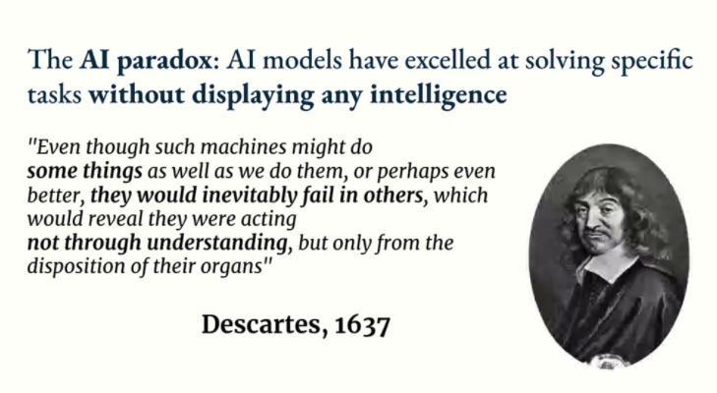
Slide due to Francois Chollet

Slide 39
The Instruction Paradigm: Challenges
Lack of natural and diverse benchmarks for learning from Instructions.
Few prior works, but they are limited!
No standard schema to represent instructions.
Unclear how to represent “instructions”!
Model response to Instructions has been poor.
Instructions are hard to learn!

Slide 40



Prior Works
Diversity of tasks
Weller et. al (2020):
Defined descriptions as common questions and built the ZEST dataset.
Crowdsourced question-like instructions→ Limited complexity
Weller et al.
where we want to be!
Efrat & Levy (2020):
Proposed the Turking Test: asking models to follow natural language instructions
Aims to address all crowdsourcing instructions at once
→ A very difficult task follow
Limited scope of study
→ Studied only 3 datasets
Efrat et al.
Naturalness of the instructions

Slide 41
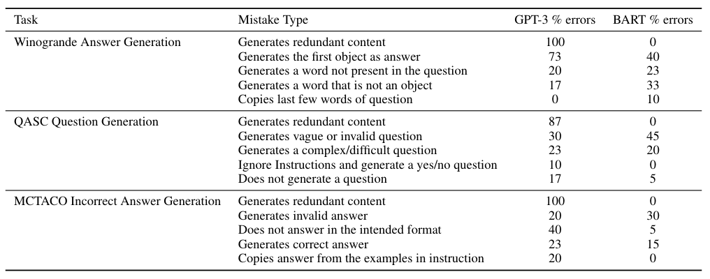
Error Analysis
GPT-3:
Often fails to follow
instruction without
any example.
Too Innovative.
Redundant content
Generation.
BART:
Too Imitative.
Provides more control,
but fails to generate
proper output.
Can we strike a good balance between imitation and innovation?
Notes:
FYI: add pointers/arrows/boxes to walk them through the important numbers.

Slide 42
Design Principles
Natural human-readable instructions.
Diversity.
Positive Examples and Explanation.
Negative instructions.
Instructions regarding what not to do.
E.g.
The generated answers should not belong to the question span.

Slide 43
Summary
Motivating Hypothesis: Instructions help in building models that generalize to unseen tasks .
To study whether language models follow instructions, we proposed an Instruction Schema, collected crowdsourcing instructions, annotations and curated them to build the NATURAL-INSTRUCTIONS dataset.
Performed Fewshot Learning and Generalization Experiments and found out that Instructions improve generalization.
GPT-3: Too innovative, BART: Too Imitative. Balance between them is what we need.
We hope this work will bring more attention to building stronger models that can generalize to a wider range of tasks.

Slide 44

Motivation
Example1: We have used Dataset-X to build a model for basic numerical reasoning (addition and subtraction).
Now, we want a model that can also support “multiplication”.
Shall I crowdsource and create a new dataset everytime?
Example 2: We have used Dataset-Y to build a model for “event” extraction.
Now, our WallStreet firm wants the model to extract all the “events” that refer to company mergers.
Shall we crowdsource another dataset to annotate “merger” events?
It’s unlikely that we will have data samples that cover all aspects of natural language
Learn from “instructions”, just like humans do for many problems

Slide 45


Goal of Our Work:
Can we enable NLP models to appropriately respond to instructional prompts?
Find the common words of these two sentences:
<sent1>, <sent2>
Language Models
Select one of the sentences in the list, that is similar to <sent1>
<list of sentences>
Output: Model Generated Text
Create a Question and Answer pair for me involving language and numerical reasoning (addition)
Input: Instructional Prompts

Slide 46
The Instruction Paradigm: Advantages
Flexibility: It allows to define a potentially-new task explicitly in natural language.
Where does this instruction paradigm stand?
It subsumes the typical paradigm of learning from task-specific input/output pairs (e.g., mapping sentences to their sentiment.)
Any task we currently solve in NLP can be expressed as “instructions”.
Learning from Instructions
Learning from task-specific input/outputs

Slide 47
The Instruction Paradigm: Challenges
Lack of natural and diverse benchmarks for learning from Instructions.
Few prior works, but they are limited!
No standard schema to represent instructions.
Unclear how to represent “instructions”!
Model response to Instructions has been poor.
Instructions are hard to learn!

Slide 48
Prior Works
Weller et. al (2020):
Defined descriptions as common questions and built the ZEST dataset.
Question format and crowdsourcing → Limited complexity
Diversity of tasks
Weller et al.
where we want to be!
Efrat et. al (2020):
Proposed the Turking Test: asking models to follow natural language instructions
Aims to address all crowdsourcing instructions at once
→ A very difficult task follow
Limited scope of study
→ Studied only 3 datasets
Clark et. al (2020):
Showed that model follows “rules” expressed in natural language.
Need to incorporate Instructions beyond rules
Efrat et al
naturalness of the descriptions

Slide 49
Talk Outline
Build a Benchmark to Learn from Instructions:
Reuse crowdsourcing datasets and their instructions.
Analysis on the Collected Data So Far
Quantitative and qualitative analysis
Assessment of Current Models:
Explore how well the current SOTA models generalize across different instructions.
Stretch Goals:
Explore external applications of models that can follow instructions.

Slide 50
Talk Outline
Build a Benchmark to Learn from Instructions:
Reuse crowdsourcing datasets and their instructions.
Analysis on the Collected Data So Far
Quantitative and qualitative analysis
Assessment of Current Models:
Explore how well the current SOTA models generalize across different instructions.
Stretch Goals:
Explore external applications of models that can follow instructions.

Slide 51

Building a Benchmark for “Instructions”
instructions
A typical data construction pipeline
Input
Output
A typical paradigm for learning the mapping from inputs to outputs (e.g., training a sentiment analysis model).
Input
Output
instructions
Our paradigm for learning to map inputs & instructions to their outputs
Input
Output

Slide 52
Building a Benchmark for “Instructions”
Step 1: Collection of crowdsourced data (and their templates) for a large number (hopefully, >=50) of datasets.
This would involve the intermediate annotations for datasets w/ multiple crowdsourcing steps.
Step 2: Conversion to a structured format
Splitting each dataset (and templates) into sub-tasks, where each sub-task represents one step of data creation process.

Slide 53
Build a Benchmark to Learn from Instructions (...)
Compiled 6 datasets:
Quoref
DROP
CosmosQA
MCTACO
Winogrande
QASC
How to come up with a careful, flexible and high-coverage schema for “instructions”?
Proposed a schema that with a variety of fields.

Slide 54
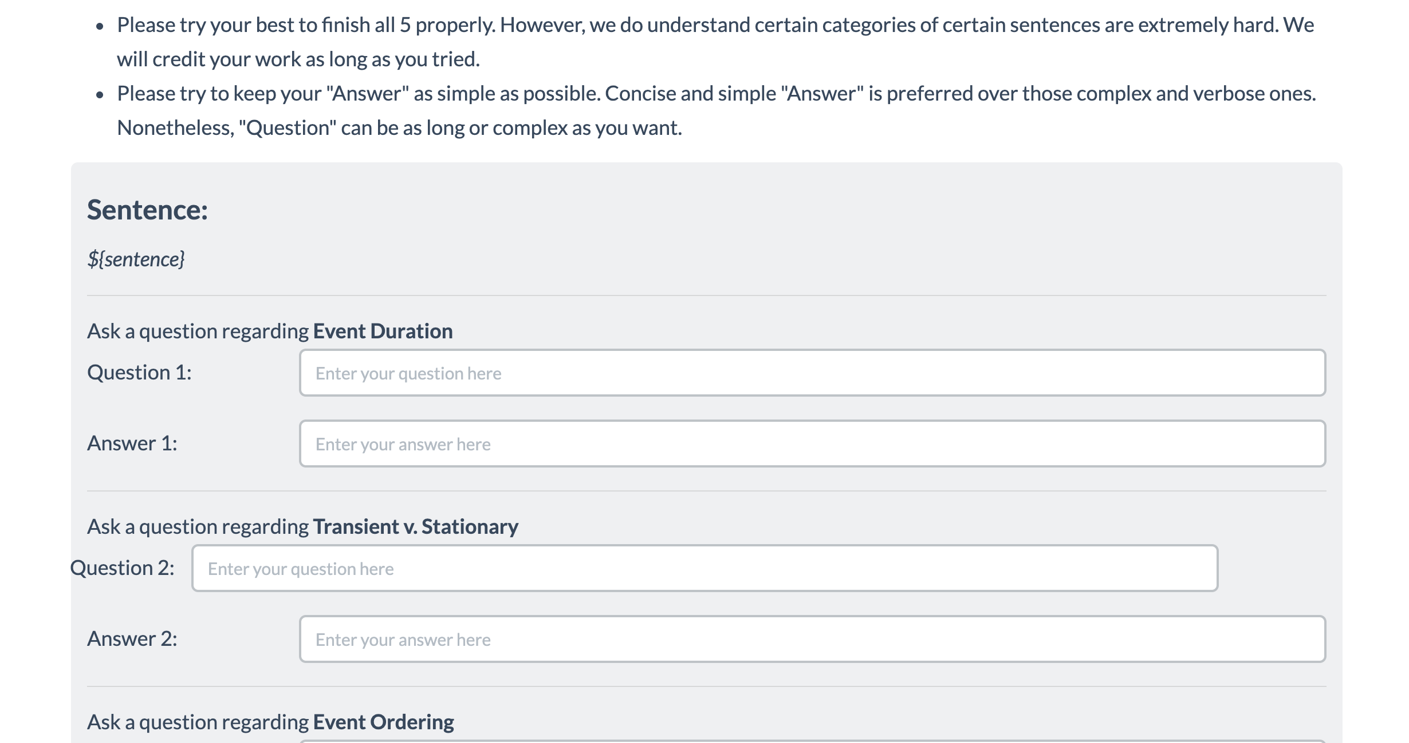
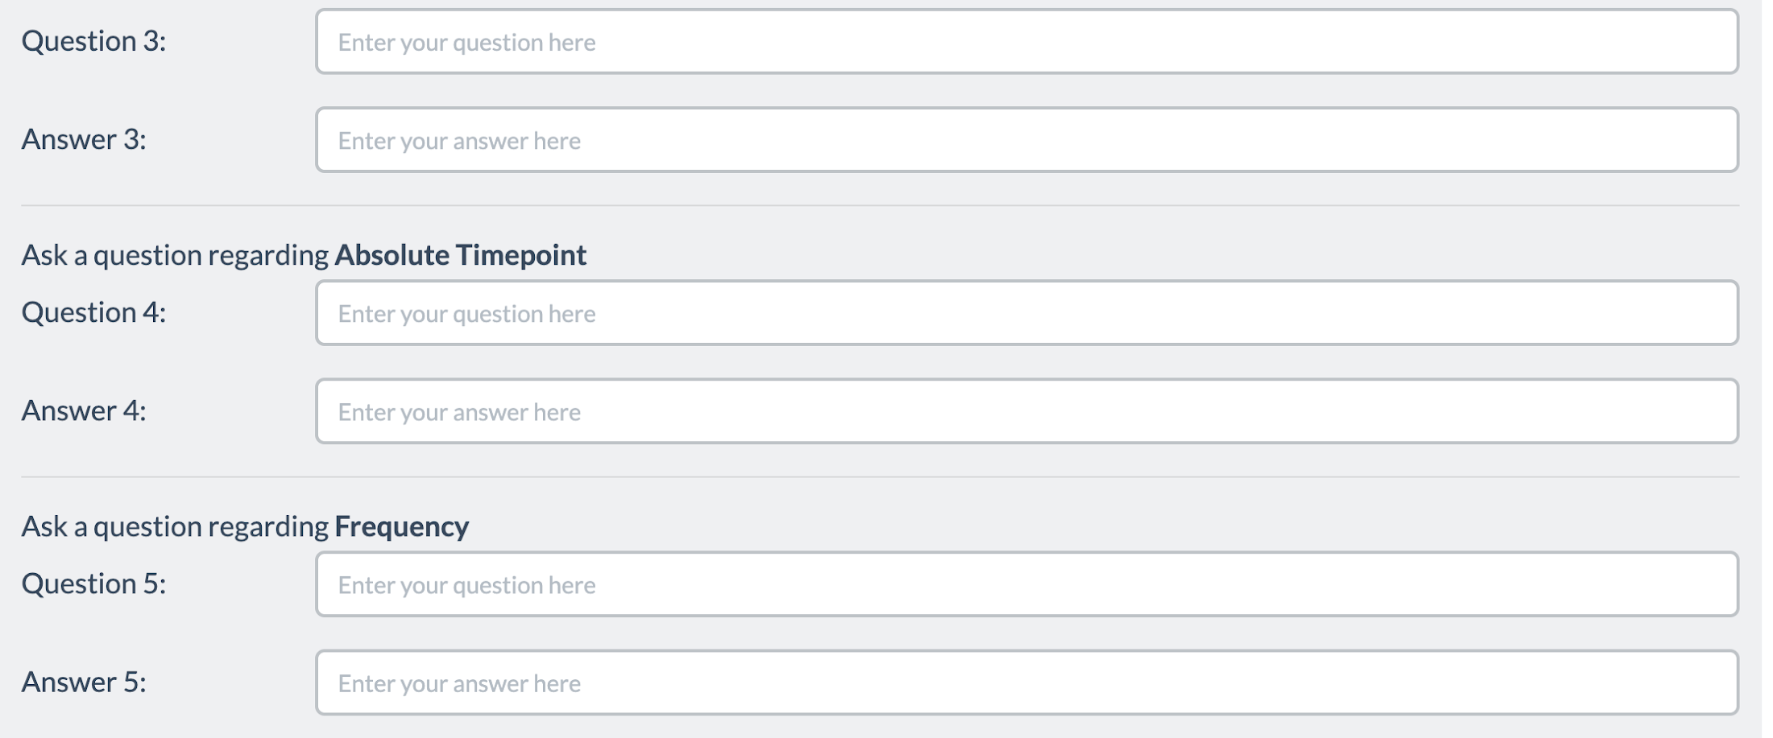
Splitting Templates into “Sub-task”
Split each template in to sub-tasks
Subtask1
Each sub-task represents one step of data creation process.
Input of each sub-task is either external input like passages or output of some other sub-task.
The output is purely collected from crowdworker annotation.
Subtask2
Subtask3
Subtask4
Subtask5

Slide 55
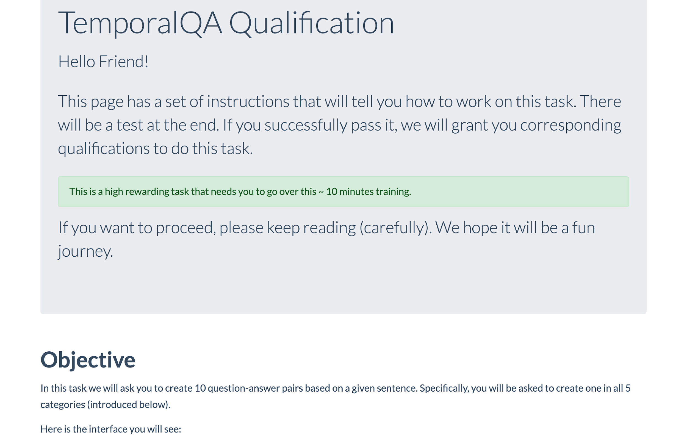
Schema Definition (1)
Sub-task Instructions:
Title
Definition
“Don’t” instructions
Emphasize/Caution
Examples:
Positive example
Negative example
Input
Output
Input
Output
Reason
Reason
Suggestion
# of examples for sub-task
Input/outputs:
Prompt message
input
output
# of sub-task instances
# of sub-tasks

Slide 56
Schema Definition (1)
Sub-task Instructions:
Title
Definition
“Don’t” instructions
Emphasize/Caution
Examples:
Positive example
Negative example
Input
Output
Input
Output
Reason
Reason
Suggestion
# of examples for sub-task
Input/outputs:
Prompt message
input
output
# of sub-task instances
# of sub-tasks

Slide 57
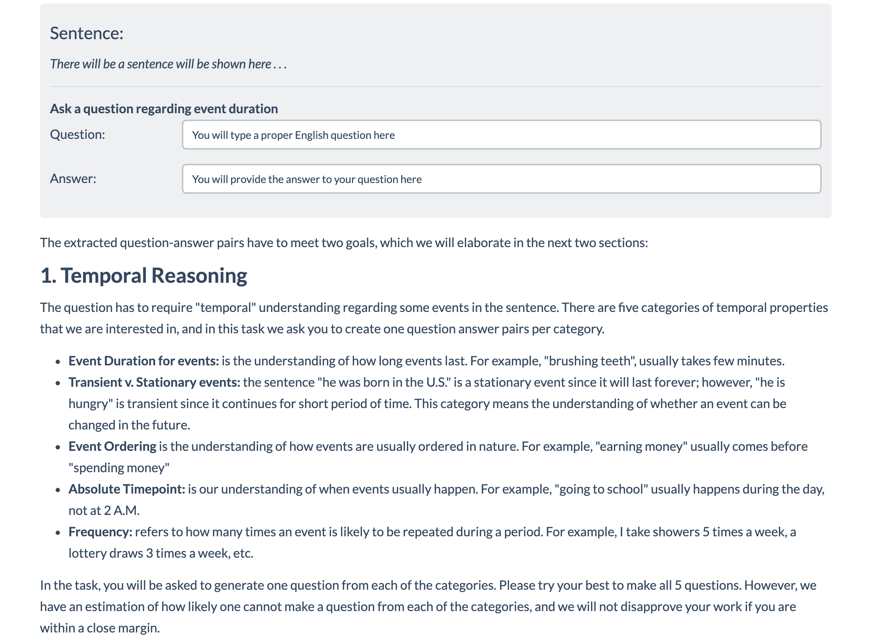
Schema Definition (2)
Sub-task Instructions:
Title
Definition
“Don’t” instructions
Emphasize/Caution
Examples:
Positive example
Negative example
Input
Output
Input
Output
Reason
Reason
Suggestion
# of examples for sub-task
Input/outputs:
Prompt message
input
output
# of sub-task instances
# of sub-tasks

Slide 58
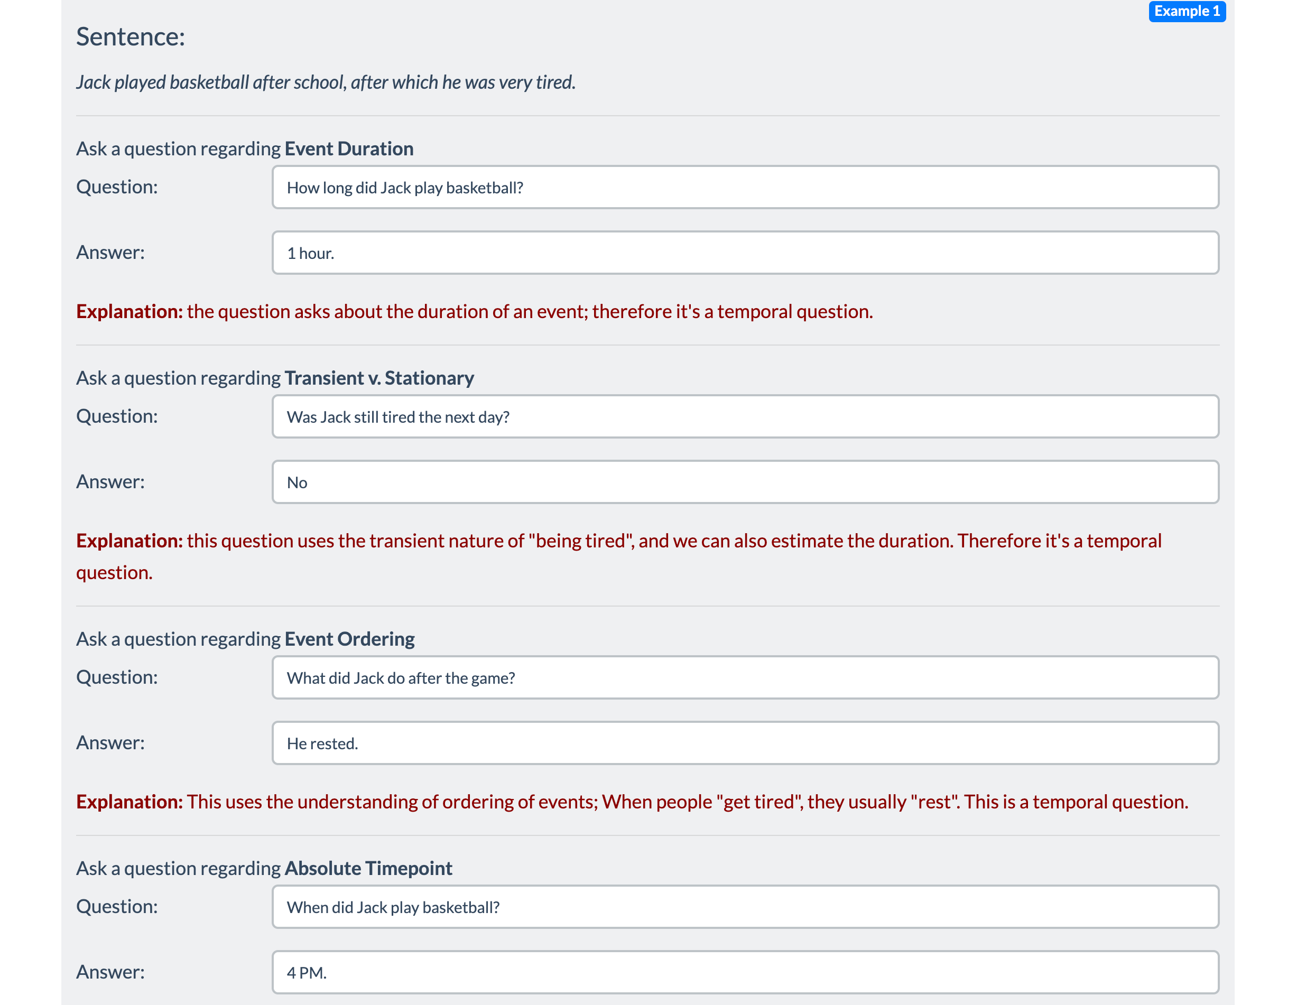
Schema Definition (3)
Sub-task Instructions:
Title
Definition
“Don’t” instructions
Emphasize/Caution
Examples:
Positive example
Negative example
Input
Output
Input
Output
Reason
Reason
Suggestion
# of examples for sub-task
Input/outputs:
Prompt message
input
output
# of sub-task instances
# of sub-tasks

Slide 59
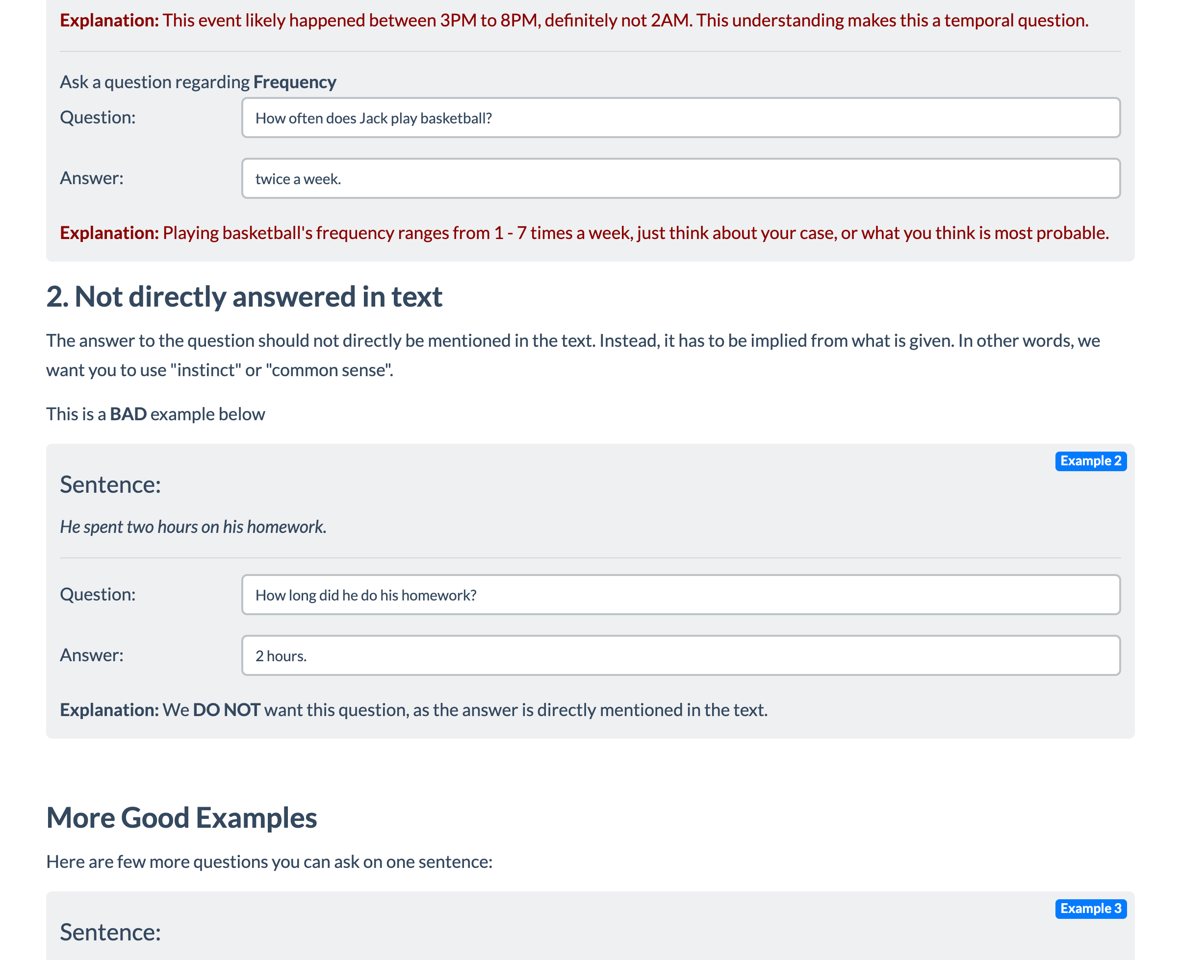
Schema Definition (4)
Sub-task Instructions:
Title
Definition
“Don’t” instructions
Emphasize/Caution
Examples:
Positive example
Negative example
Input
Output
Input
Output
Reason
Reason
Suggestion
# of examples for sub-task
Input/outputs:
Prompt message
input
output
# of sub-task instances
# of sub-tasks

Slide 60
Schema Definition (5)
Sub-task Instructions:
Title
Definition
“Don’t” instructions
Emphasize/Caution
Examples:
Positive example
Negative example
Input
Output
Input
Output
Reason
Reason
Suggestion
# of examples for sub-task
Input/outputs:
Prompt message
input
output
# of sub-task instances
# of sub-tasks

Slide 61
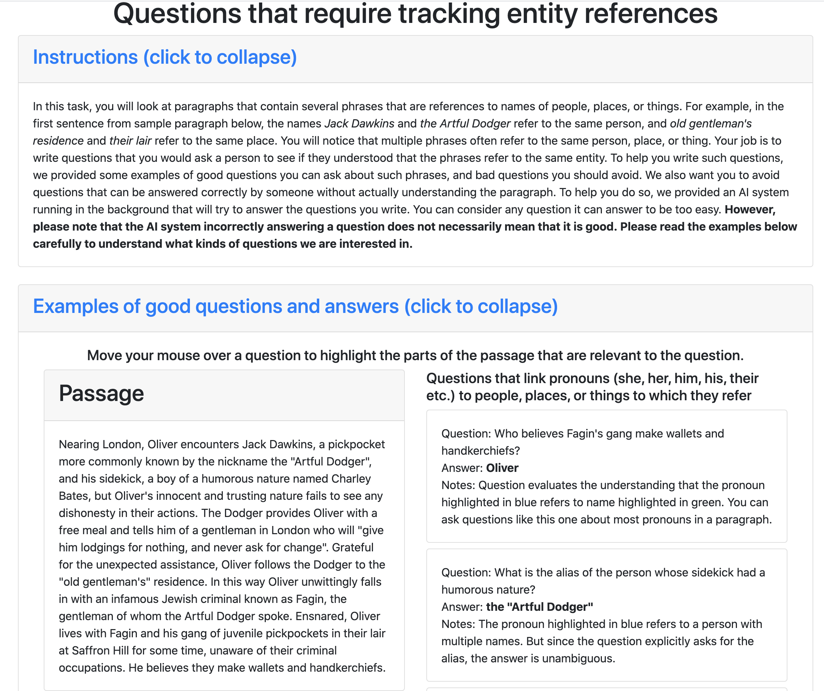
Schema Definition (6)
Sub-task Instructions:
Title
Definition
“Don’t” instructions
Emphasize/Caution
Examples:
Positive example
Negative example
Input
Output
Input
Output
Reason
Reason
Suggestion
# of examples for sub-task
Input/outputs:
Prompt message
input
output
# of sub-task instances
# of sub-tasks

Slide 62
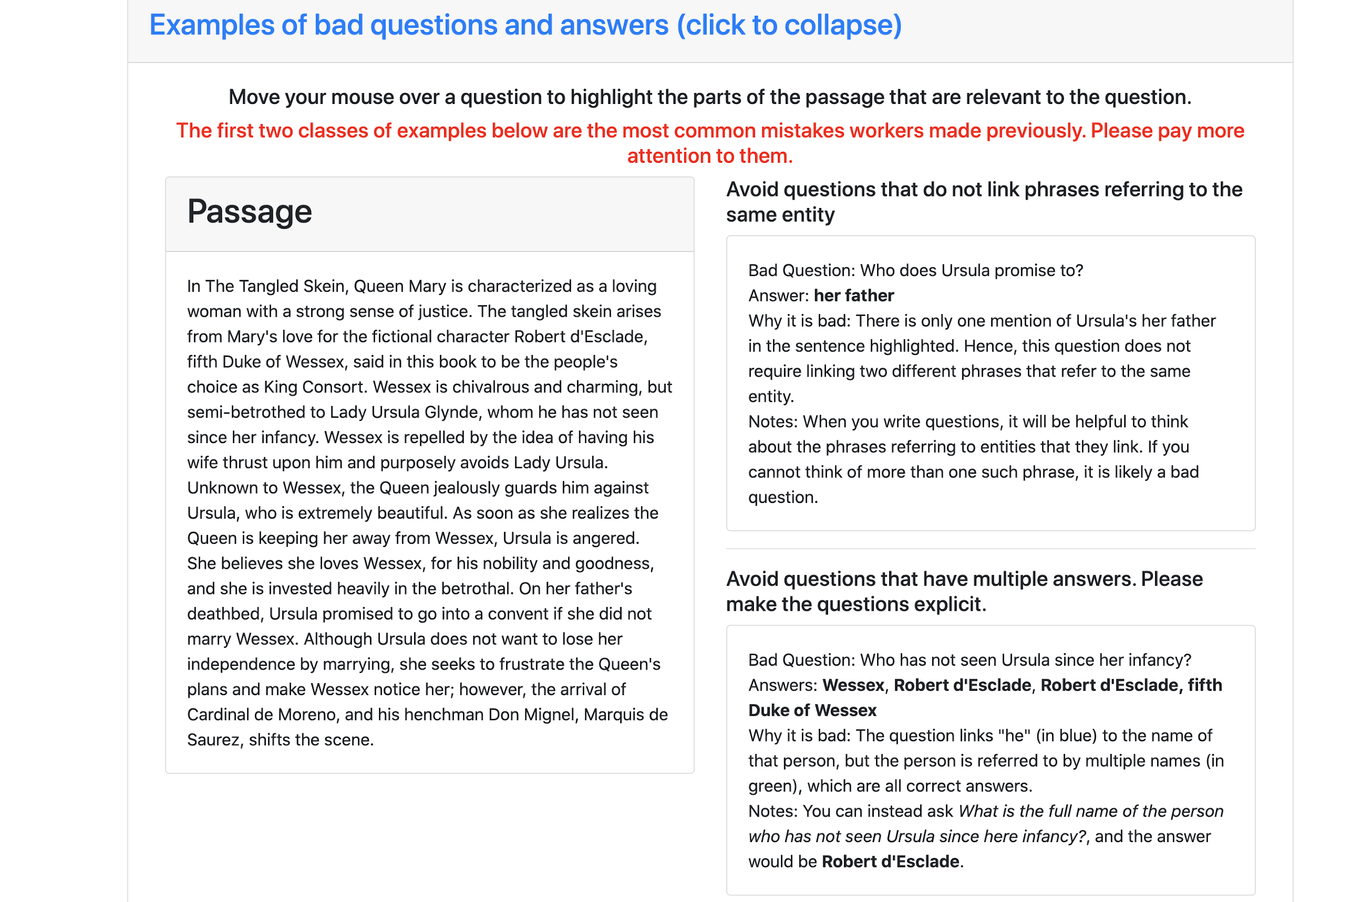
Schema Definition (7)
Sub-task Instructions:
Title
Definition
“Don’t” instructions
Emphasize/Caution
Examples:
Positive example
Negative example
Input
Output
Input
Output
Reason
Reason
Suggestion
# of examples for sub-task
Input/outputs:
Prompt message
input
output
# of sub-task instances
# of sub-tasks

Slide 63
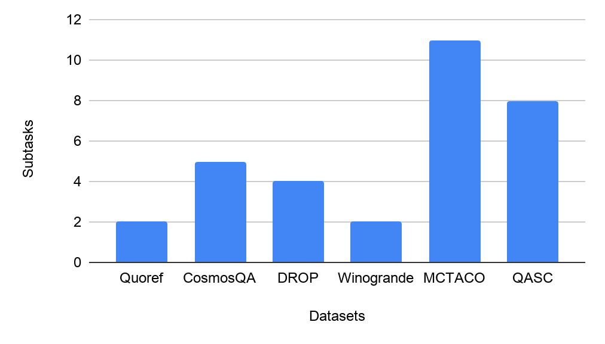
Number of Subtasks
QASC and MCTACO has relatively higher number of subtasks than the rest of the dataset.
Number of subtasks (27) is way higher than the the number of datasets (6).

Slide 64
Statistics of Instruction Set
Total number of instances: 331k
Dataset | sub-task id | # of instances
Quoref | 1 | 21,817
Quoref | 2 | 24,354
MCTACO | 1 | 629
MCTACO | 2 | 629
MCTACO | 3 | 629
MCTACO | 4 | 629
MCTACO | 5 | 629
MCTACO | 6 | 2,400
MCTACO | 7 | 2,400
MCTACO | 8 | 2,400
MCTACO | 9 | 2,400
MCTACO | 10 | 2,400
MCTACO | 11 | 2,400
Dataset | sub-task id | # of instances
DROP | 1 | 86,945
CosmosQA | 1 | 22,722
CosmosQA | 2 | 35,231
CosmosQA | 3 | 35,231
CosmosQA | 4 | 975
CosmosQA | 5 | 975
Winogrande | 1 | 43,932
Winogrande | 2 | ?
QASC | 1 | 7,653
QASC | 2 | 7,653
QASC | 3 | 7,653
QASC | 4 | 7,653
QASC | 5 | 7,653
QASC | 6 | 7,653

Slide 65
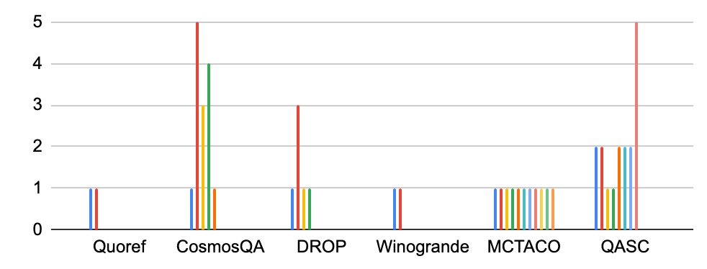
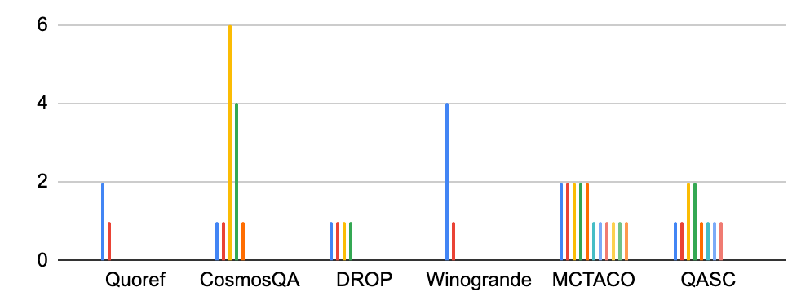
Input/Output Dimensions at each Subtask
distribution of input dimensions
Input Dimension:1
Output Dimension:2
distribution of output dimensions
CosmosQA and QASC have relatively higher dimensional instances, whereas Quoref and MCTACO have relatively lower dimensional instances.

Slide 66
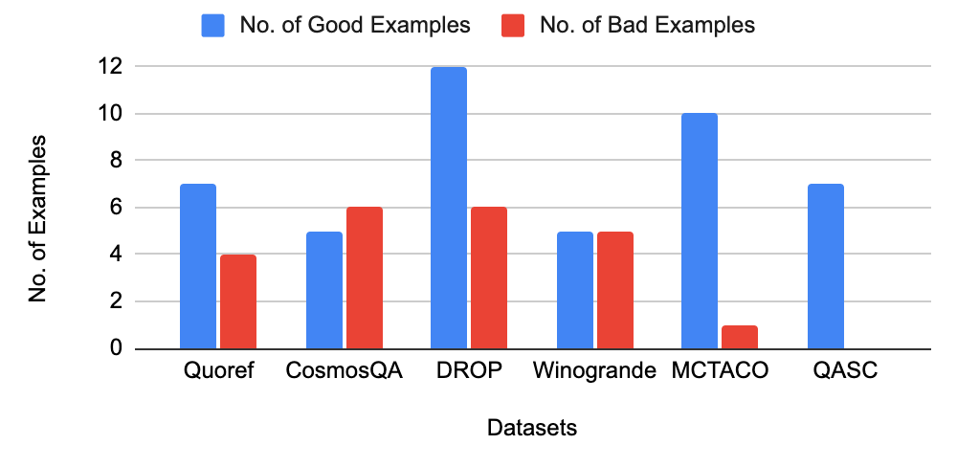
Number of Good/Bad Examples
DROP Instruction consists of relatively higher number of examples than the rest.
Only in Winogrande, no. of good examples provided is same as that of the bad examples.
QASC Instruction does not contain bad examples.

Slide 67
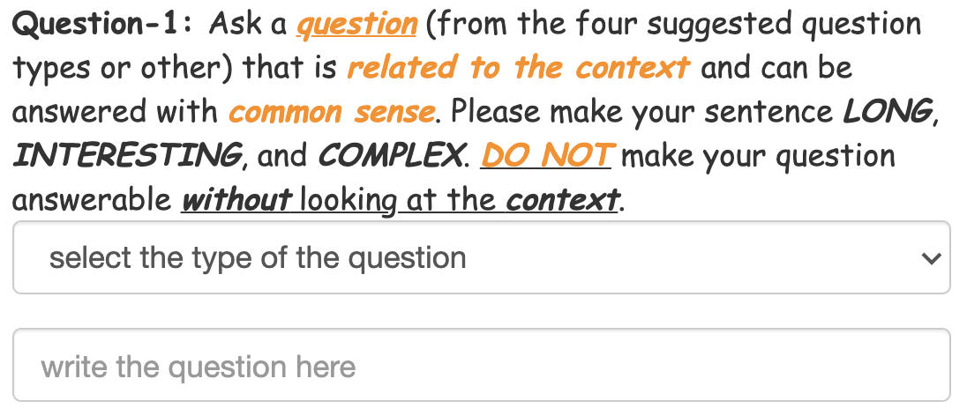
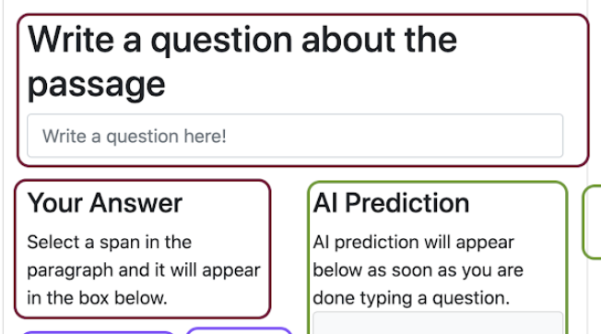
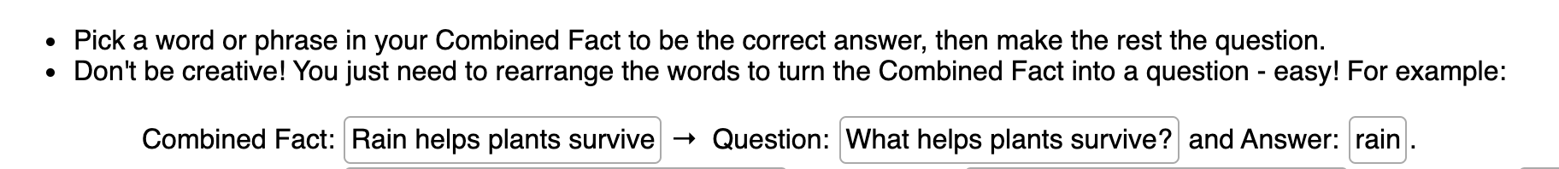
Task Specification [Dis]Similarity
Subtasks with similar objective, however the task specifications are different.
CosmosQA
Quoref
QASC

Slide 68
Topical Analysis
Even datasets with overlapping reasoning skills can have different topical distribution.
Reasoning Skill | Datasets | Topic
Coreference Resolution | Quoref, Winogrande | Quoref uses Wikipedia pages about English movies, art and architecture, geography, history, and music, whereas Winogrande uses wikihow which are very different.
Sentence Composition | DROP, QASC | QASC uses Grade school level science facts from WorldTree corpus and ck12, in contrast to the topic of source corpora in DROP.
Numerical Reasoning | DROP, MCTACO | DROP has passages from history and sports from wikipedia whereas MCTACO is based on randomly selected sentences from a diverse range of topics (news, travel guides, fiction stories etc.)
Commonsense Reasoning | CosmosQA, Quoref, MCTACO, Winogrande | CosmosQA is based on a diverse collection of everyday situations from a corpus of personal narratives and the Spinn3r Blog Dataset. Topics of Quoref, Winogrande and MCTACO are very different.

Slide 69
Analysis of Reasoning Classes
We annotate the dataset with 7 reasoning categories:
Reasoning Class | Datasets Considered
Coref. Resolution | Quoref, Winogrande
Commonsense Reasoning | CosmosQA, Quoref, MCTACO, Winogrande
Numerical Reasoning | DROP, MCTACO
Sentence Composition | DROP, QASC
Reading Comprehension | Quoref, DROP, CosmosQA
Question Answering | MCTACO, Winogrande, QASC
Fooling AI model | Quoref, DROP, QASC
There is a notable overlap between the reasoning skills required to address datasets.
This will be a point to consider when doing evaluation on the dataset.

Slide 70
Assessment of Current Models
Goal: Measure generalization across instructions:
If model M is has seen instructions (I₁, I₂, ...I_{n}), would it generalize to an unseen instruction I_{n+1}?
Partition subtasks to train/dev/test splits:
Careful to avoid data leakage and encourage generalization.
Evaluation to measure the quality of the systems:
Formalizing a reliable evaluation metric will be challenge!
Models: BART, T5, GPT3 (bonus)

Slide 71
Data Collection
Crowdsourcing our dataset?
Expensive and quality is a bottleneck.
Instead, reuse crowdsourcing datasets and their instructions (Efrat & Levy, 2020)
They are mostly curated.
Contacted dataset authors
Got access to crowdsourcing instructions and associated annotations of diverse datasets.

Slide 72
Building a Benchmark for “Instructions”
instructions
A typical data construction pipeline
Input
Output
A typical paradigm for learning the mapping from inputs to outputs (e.g., training a sentiment analysis model).
Input
Output
instructions
Our paradigm for learning to map inputs & instructions to their outputs
Input
Output

Slide 73
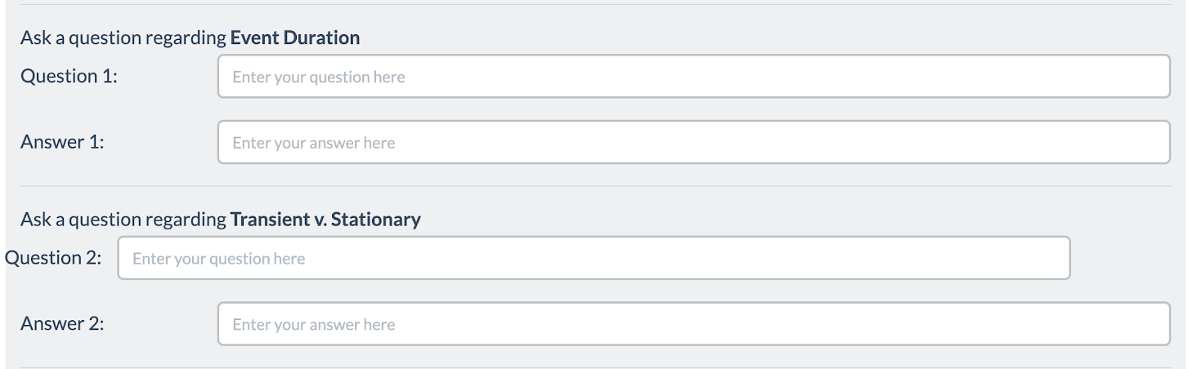
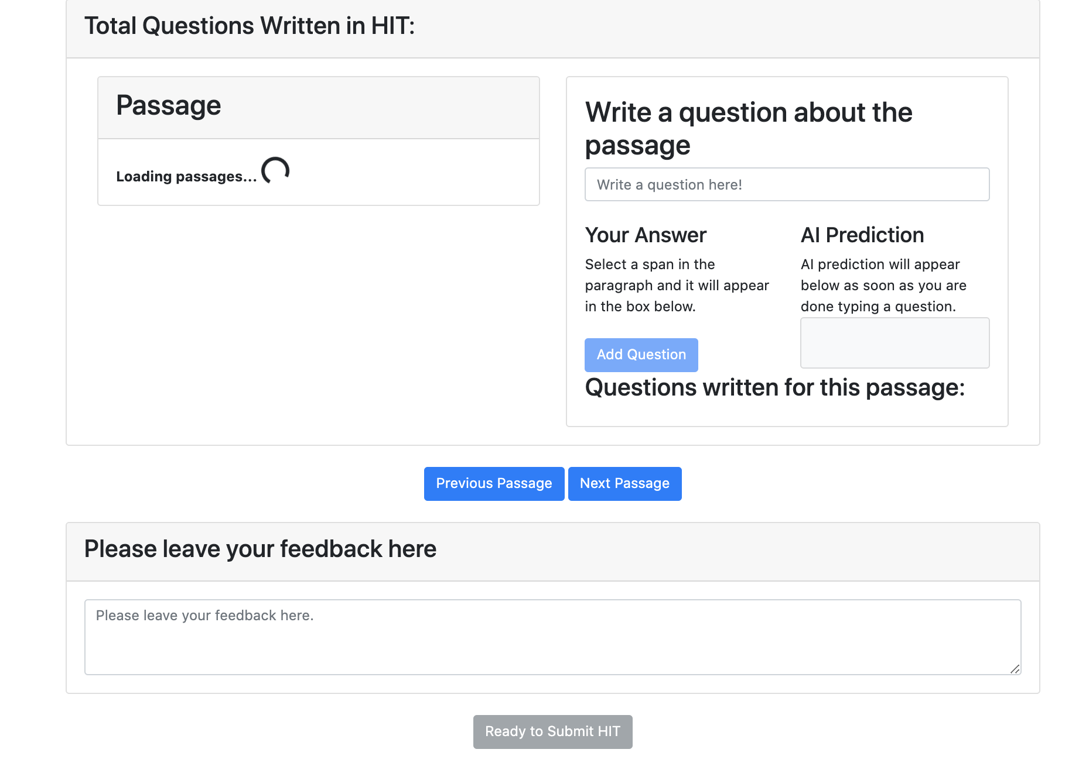
Splitting Templates into Tasks
Task1
Split each template into tasks
Task2
Each task is one self-contained annotation step
Input of each task is either external data like passages or output(s) of some of the earlier steps in annotation
The output is purely collected from crowdworker annotation.
Task3
Task4
Task1
Task2

Slide 74
Experiment: Random Split Generalization
Is there any value in out-of-format training?
40
30
20
10
0
Mixing RACE (Multiple-Choice) w/ datasets of different formats.
69.4
62.5
59.1
55.8
Notes:
The first intuition that one needs to verify is whether there is any value in mixing pairs of datasets.
(read the plots)
I don’t know about you, but when I was seeing these improvements, my first instinct was that there must be a bug somewhere.
Quite surprising how one can gain so much by creating these seemingly odd combinations.
--> more experiments in the paper Overall, empirically we see that there exists pairs of datasets with different formats that benefit from each other.
This brings us to the question of what happens when you mix multiple datasets of different format?

Slide 75
Motivation: Cross-Task Generalization
Text: She chose to make a salad for lunch tomorrow and Sunday. Question: how long did it take for her to make a salad?
“30mins”, “an hour”
“event duration”
“a valid question”
Question Answering
Question Typing
Grammar Checker
Notes:
Obviously, there are many tasks that we would like to solve in NLP.
For example, given this input which contains a text and a question, we’d like models that answer this question, type this question, for detect its writing/grammatical issues and so many others tasks.
In the current conventional paradigm, what we do is to build models for each task, typically based based on datasets built for one one.
This convention works well for individual datasets (we have good systems that work well for each dataset)
however, none is able to generalize across the tasks
e.g., a question-answering model cannot solve classification tasks.

Slide 76
Motivation: Cross-Task Generalization
Text: She chose to make a salad for lunch tomorrow and Sunday. Question: how long did it take for her to make a salad?
“30mins”, “an hour”
“event duration”
“a valid question”
Question Answering
Question Typing
Grammar Checker
Notes:
In contrary, the eutopia that I am after looks like this
Where we have a single system that has a broader scope and can solve a variety of tasks
But to make a model solve a variety of tasks, we should somehow define what expect from the model (or, what task it is solving).

Slide 77
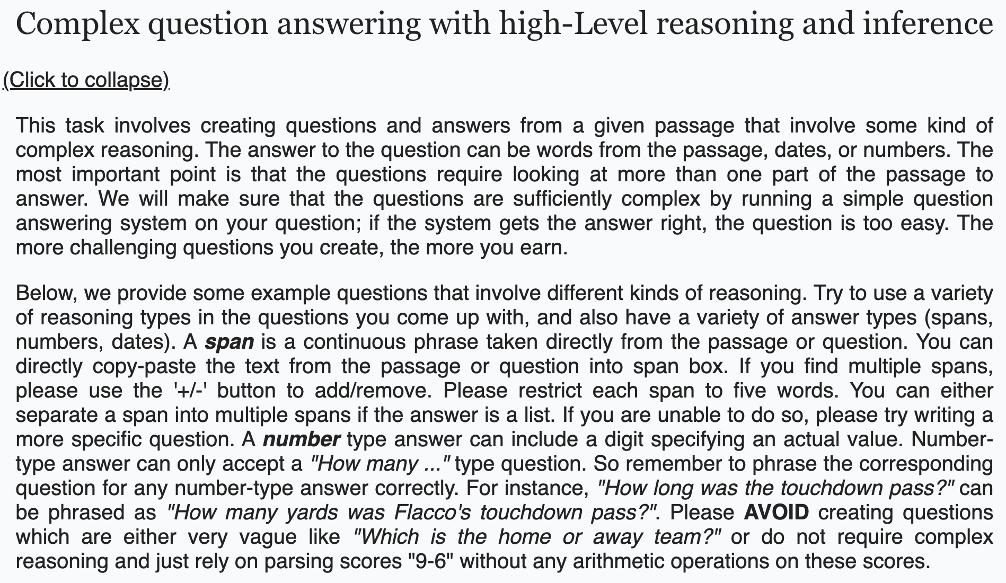
Natural-Instructions: Construction (2)
instructions schema
collecting existing datasets
Definition
Things to Avoid
Emphasize/Caution
Prompt
Positive Examples:
Negative Examples:
Positive example
Positive example
dividing crowdsourcing instructions into minimal tasks
Input
Output
Input
Output
Reason
Reason
Suggestion
instructions schema
mapping crowdsourcing instructions to the schema
DROP [Dua et al. 2019]
Notes:
TODO:
- make it a bit more compact
- just like fig 3, separate instances from the instructions
We drop uncessary sentences:
E.g., below we provide some examples:

Slide 78
Natural-Instructions: Construction (2)
instructions schema
collecting existing datasets
Definition
Things to Avoid
Emphasize/Caution
Prompt
Positive Examples:
Negative Examples:
Positive example
Positive example
dividing crowdsourcing instructions into minimal tasks
Input
Output
Input
Output
Reason
Reason
Suggestion
instructions schema
mapping crowdsourcing instructions to the schema
Notes:
TODO:
- make it a bit more compact
- just like fig 3, separate instances from the instructions

Slide 79
Annotation of Crowdsourcing Template (2)
Instructions:
Title
Definition
Things to Avoid
Emphasize/Caution
Examples:
Positive example
Negative example
Input
Output
Input
Output
Reason
Reason
Suggestion
# of examples for task
Input/outputs:
Prompt message
input
output
# of task instances
# of tasks

Slide 80
Data Curation
Mapping crowdsourcing instructions to our proposed schema:
Retained the original phrasing, converted to the simplest form by removing redundant content.
Created negative examples wherever they were absent.
Added explanations to positive and negative examples wherever applicable.
Fixed annotation issue in examples present in the template wherever applicable.
Kept the instances with high inter-annotator agreement.
Limitations:
Html information (e.g., certain organization of the information boxes) is lost while converting them into our schema.

Slide 81
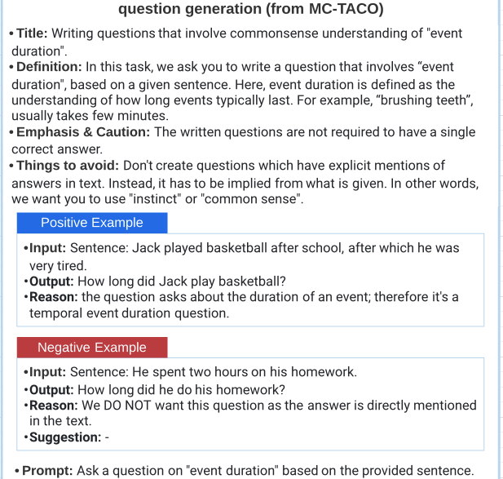
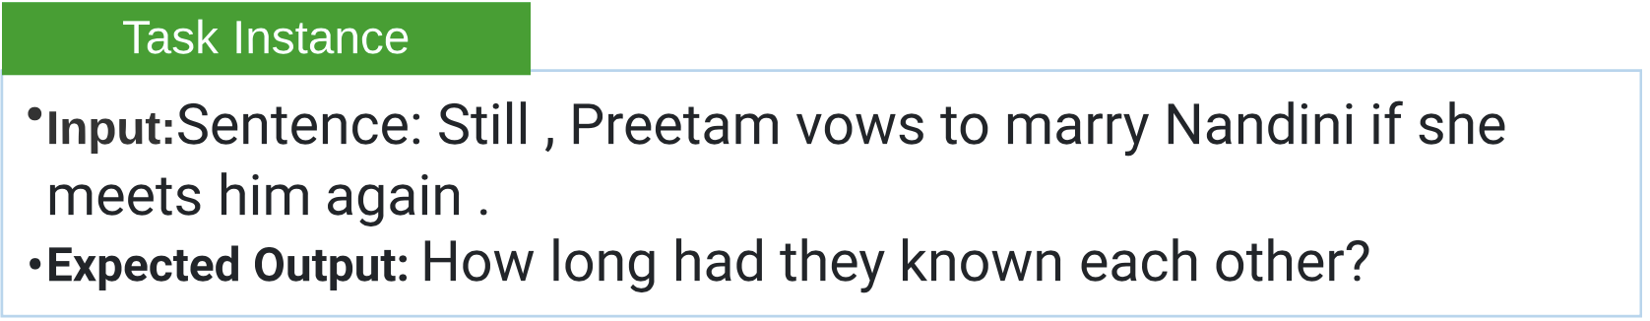
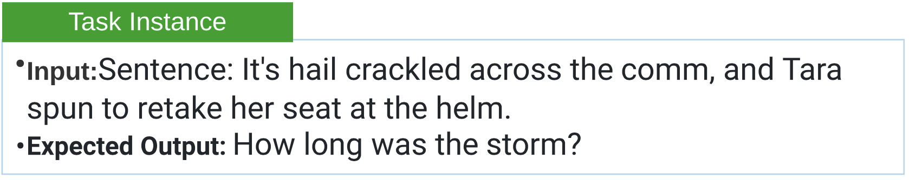
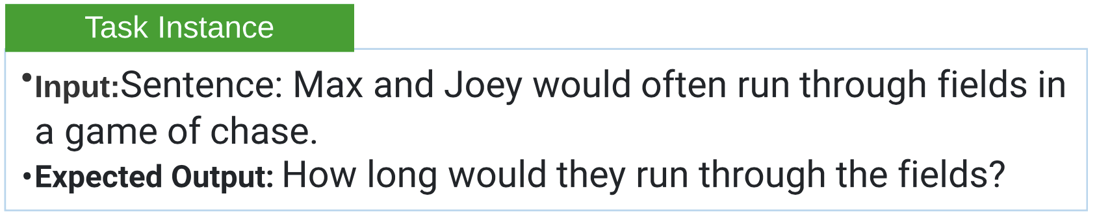
NATURAL INSTRUCTIONS: Examples
Instructions remain common across instances

Slide 82
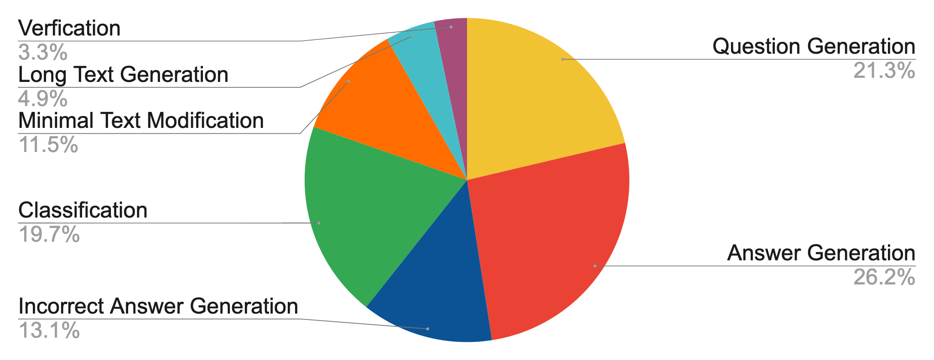
NATURAL-INSTRUCTIONS: Diversity
Tasks: ~61
Categories: ~7
Diverse Reasoning Skills:
E.g. Numerical Reasoning,
Coreference Resolution,
Commonsense Reasoning,
Multihop Reasoning.
A successful model
trained on Natural
Instructions will be a
toolbox for dataset
creation.

Slide 83
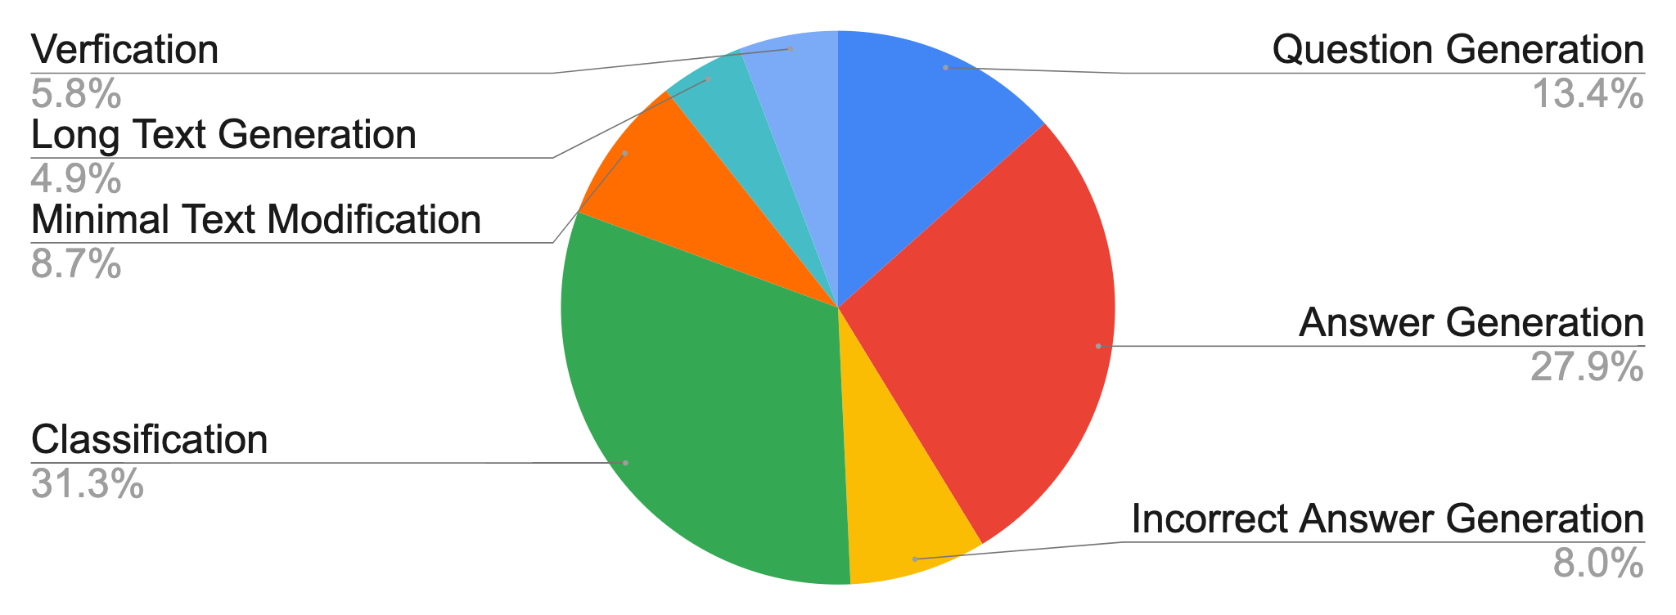
NATURAL-INSTRUCTIONS: Size Distribution
Size: ~620k
Biggest Category:
Classification
~194k
Smallest Category:
Long Text Generation
~30k

Slide 84
Experimental Setup
Data Splits
Eval Split (35 tasks) which accept a relatively reliable automatic evaluation.
Non-Eval Split (26 tasks), ensuring representation of each category of task
Models: text to text models
Few Shot GPT-3: prompting it with a few inference-time examples
Generalization BART: supervised with “non-eval” tasks.
Evaluation metrics.
BLEURT
ROUGE-L

Slide 85
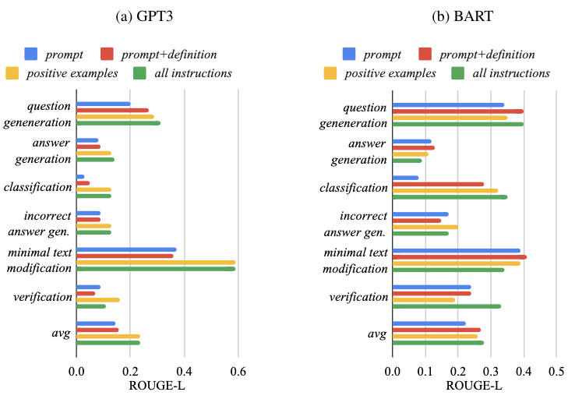
Category-wise Analysis of Instruction Benefits
The benefit from
instructions heavily
depends on the task
at hand.
For GPT-3 (left)
minimal text modification
category benefits a lot from
following instructions,
while the benefits to the
verification tasks are minimal.

Slide 86
Ablation of Instruction Encodings
GPT-3 on 3 distinct tasks
answer generation from Winogrande;
question generation from QASC;
verifying temporal reasoning
category of a given question
from MCTACO
59
56
54
Percentage Improvement
on “Prompt”
only encoding
23
GPT-3 benefits the most from positive
Examples, mildly from definition and
deteriorates with negative examples.
15
10
-13
Definition
Def &
Pos Ex.
Emphasis
Pos. Ex.
Things to Avoid
Pos. &
Neg. Ex.
Neg. Ex.

Slide 87
Results: Generalization Experiments
Task Specific Model
Instructions improve
generalization to unseen
tasks.
0.63
Instructions also improve
few shot performance.
ROUGE
0.28
0.27
0.26
0.24
0.24
0.22
0.17
0.16
NATURAL-INSTRUCTIONS has a wide margin to be solved.
0.14
Instance only
Prompt
Prompt+Def.
Pos. Ex.
All Instructions
BART GPT3

Slide 88
“definition: ${def}
things to avoid: ${avoid}
emphasis/caution: ${emphasis}
Positive example1:
input: ${ex_in}, output: ${ex_out}, reason: ${ex_reas}
prompt:${prompt}
input: ${input}
output:”

